Slide 1

Open Access, visibility and Publishing ethicals aspects
16 May 2022
Clémence Belvèze
Damien Belvèze
Notes:
Titre de la présentation
07/03/19
Université de Rennes 1
1

Slide 2
Why do we publish?
For whom?
1
Notes:
Titre de la présentation
07/03/19
Université de Rennes 1
1
Quizz : no trap at all, only a simple question, but sometimes it worths recalling the basics !
What is the point of publishing ? First be read, share the results of our research.
For whom? scholars, but also people outside Academia : citizen, firms, associations, etc.
There is of course a pressure to publish as many papers as possible in a shorter time range, but do not forget that your goal is not to become a prolific researcher but to make your research as visible and easy to access as possible.
Hope one day we will not say “publish or perish” but “publish and shine”
motto : slow down the frantic rhythm of publication in order to improve the quality of each published item (=slow science)
“Remember the old philosophical conundrum passed down from generation to generation by kids in school: If a tree falls in the forest and no one is around, does it make a sound. Well the graduate school version of that question out to run as follows: Is it a contribution to scholarship if no one reads it? (2004, pp. 18‐19).”
(Lindsay Waters, 2004)
Titre de la présentation
Université de Rennes 1
1

Slide 3
Traditional way of publishing
Subscription journals
Open Archiving
Commercial open access publishing (aka Gold Open Access)
Non-profit Open Access publishing (aka Diamond Open Access)
Funders requirements for Open Access
1
Notes:
What we will call traditional model of publication here is the journal available under subscription, as we know it since the publication of the Journal des sçavans since late seventieth century (1685 to be specific). It is the earliest academic journal published in Europe. It currently focuses on European history and premodern literature
Someone or some institution pays a subscription to get access to scientific content mediated by a serial.
We oppose this “traditional model” (or paywalled journal model) to the open access model that the Internet revolution made possible.

Slide 4
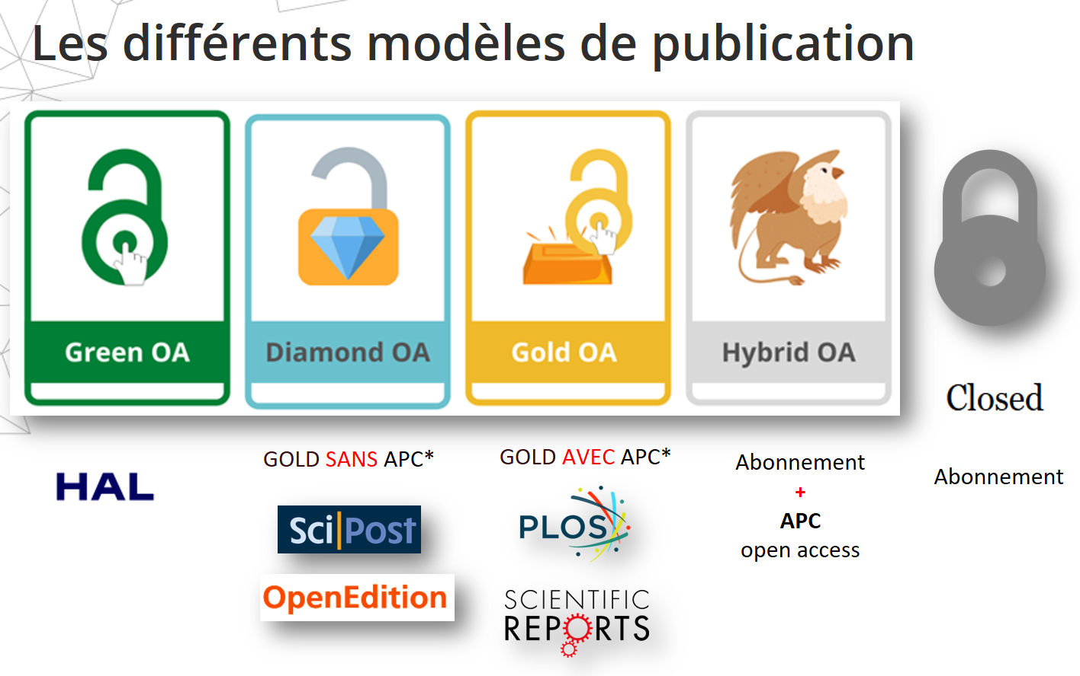

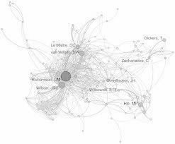
Modes of diffusion and publication
Open Access
“Grey” sharing
“Traditional” publication
(access via subscription)
Reading open to all on the web
Diffusion without publication process, no reuse licence
ex : social networks

Slide 5
Many Roads lead to Open Access…
some are more dangerous

Slide 6
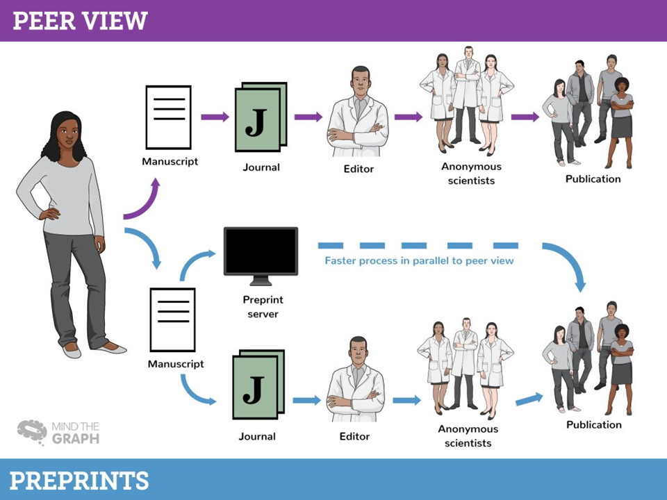
Notes:
traditional model:
a researcher submits a manuscript to a journal, the publisher organizes the peer-review process (from the 60ies) by gathering experts on the topic to assess the manuscript. If the manuscrits meets the journal quality standards, it will be published (the whole process can take 6 to 10 months)
In 1990, researchers of the Los Alamos University launched a repository in which authors can make their manuscripts available to the scientific community while it is peer-reviewed. This repository still exists and has gained in three decades a great popularity. It’s called ArXiv (https://arxiv.org). arXiv is a free distribution service and an open-access archive for 2,060,753 scholarly articles in the fields of physics, mathematics, computer science, quantitative biology, quantitative finance, statistics, electrical engineering and systems science, and economics.
The rise of preprints in other fields than mathematics, engineering and physics is more recent. In medical sciences, BioRxiv was created in 2013, MedRxiv in 2018. At the beginning, publishers were not very enthousiastic about this, but they finally accepted that preprints would be available from these repositories.
Elsevier took control over SSRN preprints database by acquiring it in 2017.

Slide 7
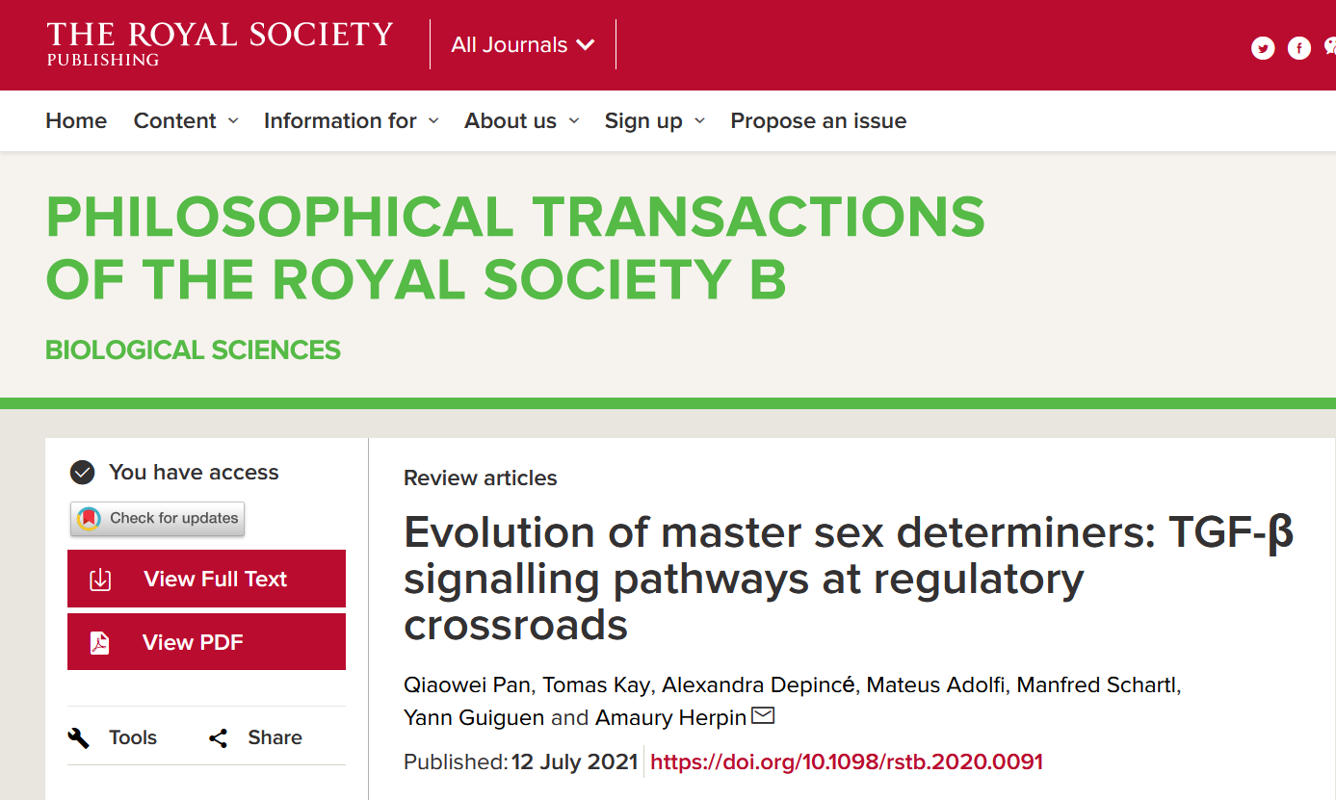

QUIZZ : who funded this paper?
1
Notes:
paper available through on ResearchGate https://www.researchgate.net/publication/353194881_Evolution_of_master_sex_determiners_TGF-b_signalling_pathways_at_regulatory_crossroads
The funding agencies are mentioned at the end of the paper, before the bibliography:
This work was supported by the AquaCRISPR (ANR-16-COFA-0004-01), the TUNESAL (HAVBRUKR Research Council of Norway, project 301602), and 111 (China, grant no. D20007) projects to A.H. Q.P. and T.K. are supported by the University of Lausanne and Q.P. is supported by a grant from the Swiss NSF (310030B_176406) to Laurent Keller.

Slide 8
Notes:
traditional model:
a researcher submits a manuscript to a journal, the publisher organizes the peer-review process (from the 60ies) by gathering experts on the topic to assess the manuscript. If the manuscrits meets the journal quality standards, it will be published (the whole process can take 6 to 10 months)
In 1990, researchers of the Los Alamos University launched a repository in which authors can make their manuscripts available to the scientific community while it is peer-reviewed. This repository still exists and has gained in three decades a great popularity. It’s called ArXiv (https://arxiv.org). arXiv is a free distribution service and an open-access archive for 2,060,753 scholarly articles in the fields of physics, mathematics, computer science, quantitative biology, quantitative finance, statistics, electrical engineering and systems science, and economics.
The rise of preprints in other fields than mathematics, engineering and physics is more recent. In medical sciences, BioRxiv was created in 2013, MedRxiv in 2018. At the beginning, publishers were not very enthousiastic about this, but they finally accepted that preprints would be available from these repositories.
Elsevier took control over SSRN preprints database by acquiring it in 2017.

Slide 9
Should we have to pay in order to access scientific literature?
1
Notes:
Do you think this is fair ?
...given that tax payers fund research and pay scientists to publish and review papers and that this material is ceased to publishers with no cost at all. What should be a justified gain for publishers added value?

Slide 10

subscription costs in Rennes 1
2021 Total expenses : 1 212 000 M €
about 1000 euros by researcher
average annual increase of subscription costs : 1-2 %
Deal cancellations : Springer (in 2018)
subscription fee for Science Direct only : 406 232 €
subscription costs in Rennes 2
1
Notes:
Titre de la présentation
07/03/19
Université de Rennes 1
1
note to self : these figures should be updated (and Rennes 2 ones should be added)
Couperin : consortium of libraries which negociate the purchases of scientific journals and databases, to obtain moderate prices.
Those prices have kept on increasing far quicker and higher than inflation rate.
In 2018, our subscription to Elsevier journals had cost the price of a Ferrari Testarossa.

Slide 11

Scientific Publishing Global Market :
The €£$evier case
Revenue for 2020 (STM) : 3 129 M €
After Tax Net profit : 38 %
Subscription fee for Elsevier : 406 232 €
Margin for Shareholders (37%) : 154 368 €
Sources : Relx – Financial Summary by market segments in Annual reports & Financial statements . PDF en ligne (2018)
1
Notes:
Titre de la présentation
07/03/19
Université de Rennes 1
1
Elsevier and a few others are monopolistic information providers in STM areas. Research in Humanities is usually published by far smaller stakeholders. But Elsevier is not only prominent as Publisher of Science Direct database but has acquired or developed also bibliometric tools (Scopus), reference managers (Mendeley), preprint servers (SSRN mainly used in Humanities), Research output analysis tool (Sci-Val) that are used by scholars and institutions in every fields of research.
Titre de la présentation
Université de Rennes 1
1

Slide 12
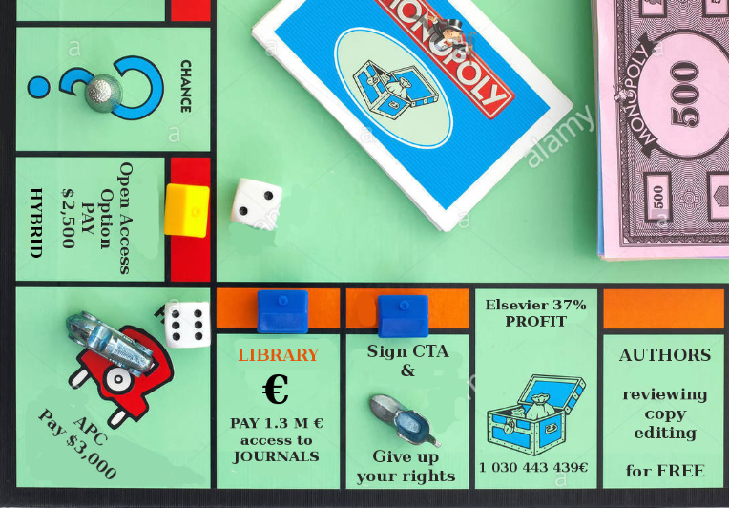
1
Notes:
Hybrid publishers like Elsevier do not really give the choice to institutions between paying for access or for publishing. Usually the university will have to pay double : once to allow the University Library to give access to the whole database (whose records stay mainly paywalled), twice to grant scholars credits for publishing in open access in Elsevier journals.

Slide 13
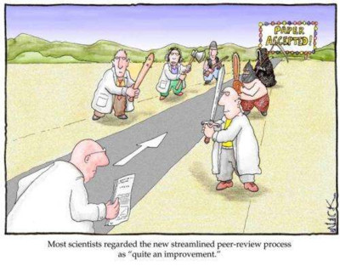
Klaxoon : first question
https://app.klaxoon.com/join/W8VNEZZ

Slide 14
Scientific publishing models
Subscription Journals
Open Archiving
Commercial open access publishing (aka Gold Open Access)
Non-profit Open Access publishing (aka Diamond Open Access)
Funders requirements for Open Access
1
Notes:
First way to open access : the green way.
Consider the traditional model, there is a mean to regain control : deposit an open access copy in an institutional repository

Slide 15
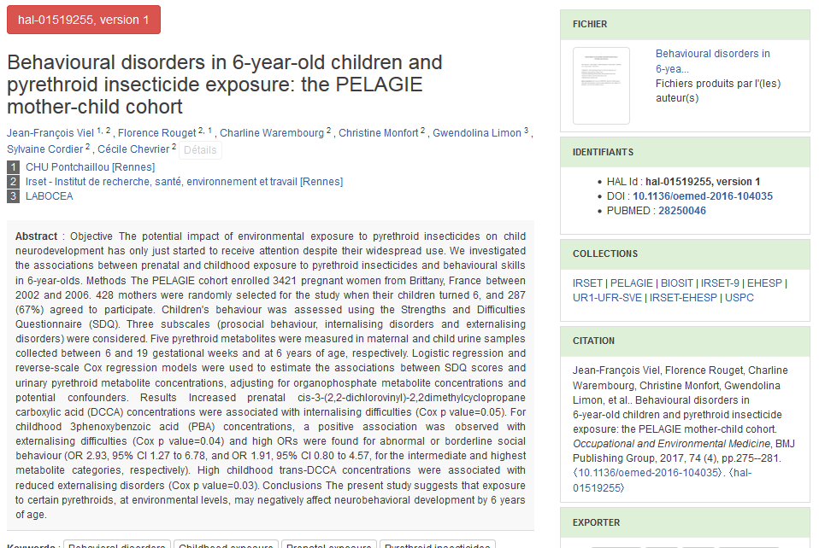
1
Notes:
Titre de la présentation
07/03/19
Université de Rennes 1
1
Green Road = Open Access Archiving (example HAL or HyperArticle on Line) : every term is important
Open means (immediately) accessible but also reusable (importance of the chosen licence, by default on HAL it’s the French Copyright that does not allow that much a priori - Open Science needs open licences such as creative licences) - creative commons. A CC license is used when an author wants to give other people the right to share, use, and build upon a work that the author has created.
Access means that it does not make sense to index a paper in HAL without providing access to the text. Do not trust publishers when they (like Dalloz) say they will index your papers in the French repository : they will only make the abstract available, not the content itself : it is not open access
Archive, means, well that your text will be archived for the rest of Human history which is a great thing since on the web, as you know, everything is so ephemeral. Backup. Even recently created open access journals can disappear without leaving any traces : https://asistdl.onlinelibrary.wiley.com/doi/10.1002/asi.24460
Once you have deposited a copy on HAL, you will not be able to remove it from the CINES servers any more, but you may provide as many versions of the original text as you wish.
Titre de la présentation
Université de Rennes 1
1

Slide 16

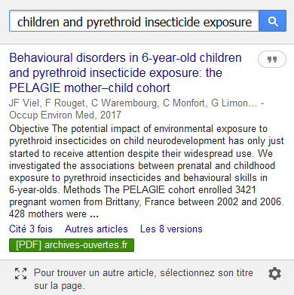
1
Notes:
Titre de la présentation
07/03/19
Université de Rennes 1
1
A paper deposited in HAL is well indexed by Google Scholar, especially if the full text can be obtained.
Titre de la présentation
Université de Rennes 1
1

Slide 17
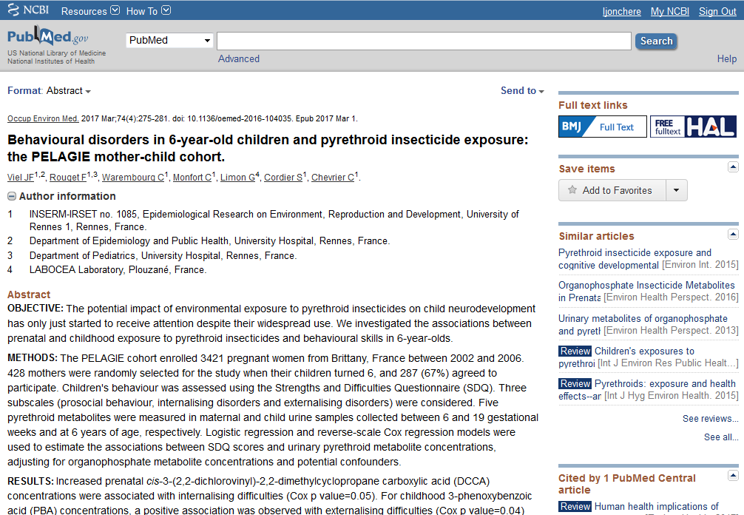
1
Notes:
Titre de la présentation
07/03/19
Université de Rennes 1
1
Pubmed is connected to HAL. Every result for which there is a document available in HAL is identified as such

Slide 18
Is it legal?
1
Notes:
Titre de la présentation
07/03/19
Université de Rennes 1
1
Titre de la présentation
Université de Rennes 1
1

Slide 19
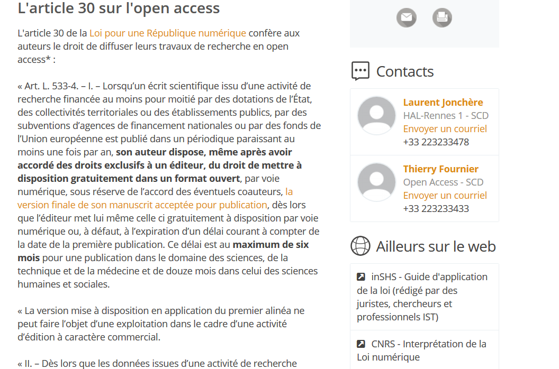
1
Notes:
Titre de la présentation
07/03/19
Université de Rennes 1
1
The French Law “Loi pour une République numérique”, also called by the name of its rapporteur (Le maire’s Law) in 2016, stated that:
when your article (conference papers are excluded from these provisions) is funded at a minimum of 50% by public funds, whatever is the contract you have signed with your publisher, you have the right to make a copy available in open access 6th months after the day of publication if it’s an article in Science Technology or Medicine, or one year, if it’s an article in Human Sciences.
The gap between STM and HS on that matter is linked to the publishing scientific ecosystem. In Human Sciences, at least in France, publishers are smaller, their business model depends more on subscriptions. If the embargo period is too small, they will have problems to sell enough subscriptions for their living, at least this is what Publishing lobbyists used to tell to MP when the Law was discussed in 2016.

Slide 20
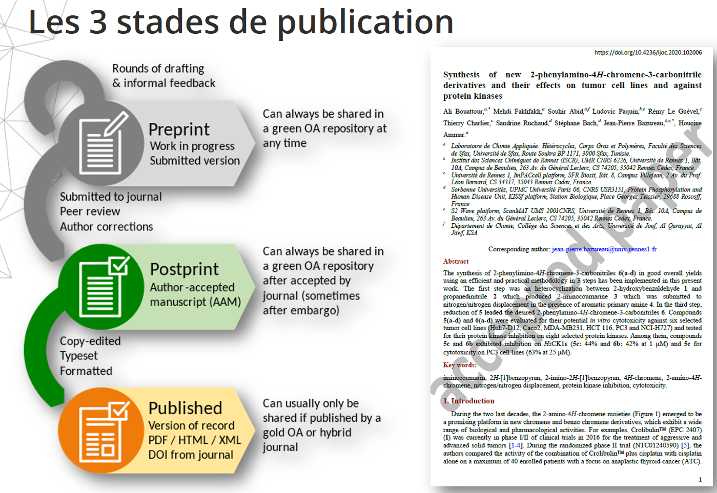
Notes:
Just in order do help students distinguish between the different versions of a paper:
preprint : not has yet been reviewed (but can be posted on a preprint server such as ArXiv)
postprint (or AAM) : the accepted version without the publisher layout and publisher’s marks
the published version (which can be read on the publisher’s website)

Slide 21
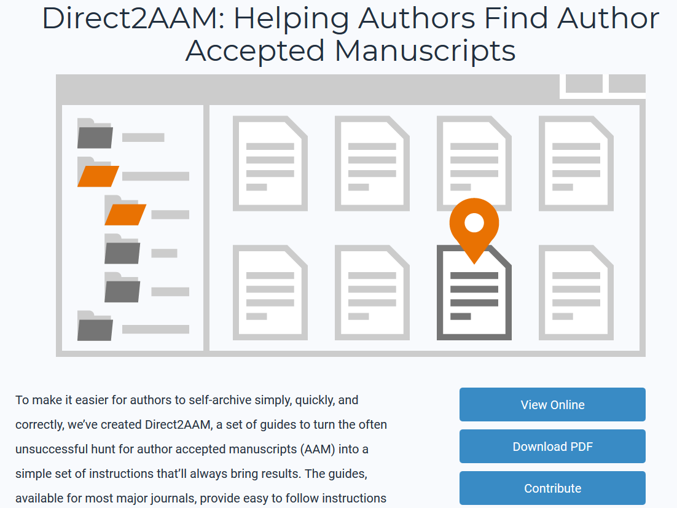
1
Notes:
Titre de la présentation
07/03/19
Université de Rennes 1
1
https://openaccessbutton.org/direct2aam
Editorial Manager, ScholarOne, eJournalPress, Manuscript Tracking System, etc.
In most cases, the version you have to store in HAL is the AMM (Accepted Author Manuscript), i.e the manuscript accepted by the publisher once the peer-reviewed process has been completed.
This is very important to save this AAM version!
Publishers should send you this version, if they don’t, you may find it by using this webservice called Direct2AAM
If you do not succeed in using this tool, ask directly the publisher, then tell us.
Sometimes it’s possible to remove Publishers fingerprints from the document in order to get a version quite similar to AAM. Sometimes, the publisher accepts that you deposit his PDF.
Open access policies set by scientific publishers are available on SherpaRomeo (https://v2.sherpa.ac.uk/romeo/ )
for french-speaking journals open access policies can be found in Mir@bel https://reseau-mirabel.info/ressource/4/OpenEdition-Journals
Titre de la présentation
Université de Rennes 1
1

Slide 22
What about PhD dissertations?
1
Notes:
Titre de la présentation
07/03/19
Université de Rennes 1
1
Titre de la présentation
Université de Rennes 1
1

Slide 23
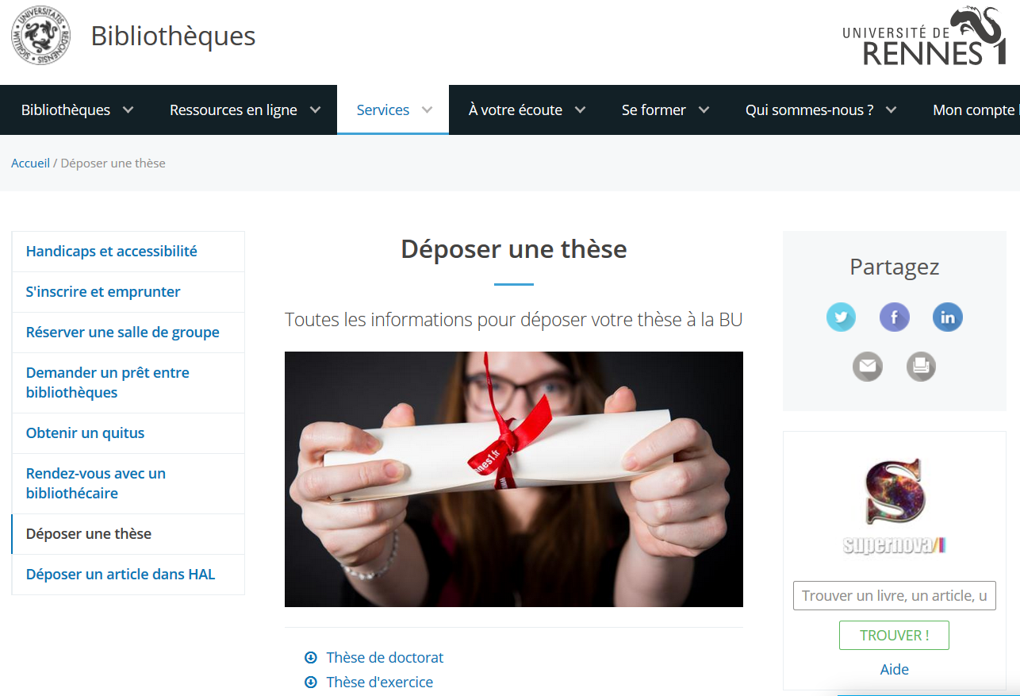
1
Notes:
Titre de la présentation
07/03/19
Université de Rennes 1
1
For ten years, the digital version of a PhD Dissertation presented in Rennes 1 has been the digital version. You have author rights on this dissertation. You have the following choices:
make your dissertation immediately available on the web (open access)
set an embargo to the publication on open access (this embargo should not exceed a year). It’s likely if some datas or informations are confidential
restrain your dissertation from being exposed on the web (but you cannot prevent people of Rennes 1 university to access it)
The best strategy is to put your thesis immediately available to all on open access because you get visibility and reputation. You will get citations.It’s also a way to protect your work from plagiarism.

Slide 24
What should you be careful about while including material in your dissertation
  as much as possible, choose material (images, graphics, plots) under open licences.
  https://search.creativecommons.org/
  When you have to reuse copyrighted material, try to get the authorization to reproduce it from the publisher or the author
What should you be careful about while including articles you have published in your dissertation
  The AAM version should be prefered to the publisher’s version
  You will have to obtain co-authors agreement.
1
Notes:
Titre de la présentation
07/03/19
Université de Rennes 1
1
Note that, thanks to an exception to the French Law on intellectual property, you can make your dissertation available on open access even if this dissertation contains works for which you do not have the reproduction rights, as long as this copy is stored in a public repository.
If you want to make a book from your thesis and sell it with the help of a publisher, you will not be covered by this exception anymore and will have to get permission from the authors to reproduce these works or replace them by material under open licences.
Titre de la présentation
Université de Rennes 1
1

Slide 25
Klaxoon : second question
https://app.klaxoon.com/join/N5FUXQS

Slide 26
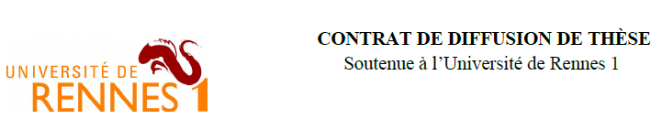
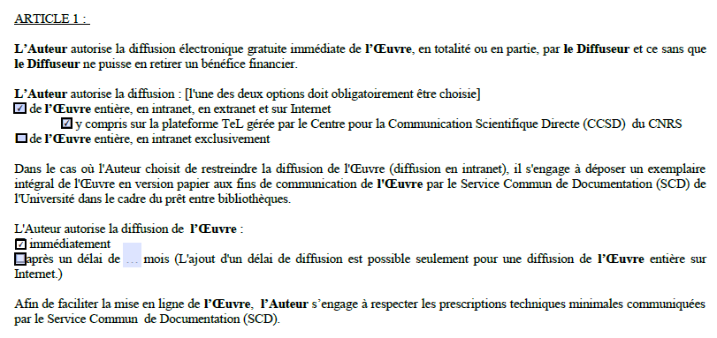
Important : cocher cases pour les modalités de diffusion
1
Notes:
Titre de la présentation
07/03/19
Université de Rennes 1
1
Rennes 1 :
PhD student must sign three copies of an agreement. Article 1 should be signed in order to allow the library to make the dissertation available on the web (on TEL repository which will be indexed by Google scholar and Theses.fr)
Montrer le site web des BU de Rennes 1 en anglais
Titre de la présentation
Université de Rennes 1
1

Slide 27
Scientific publishing models
Subscription journals
Open archiving
Commercial open access publishing
Non-profit Open Access publishing (aka Diamond Open Access)
Funders requirements for Open Access
1
Notes:
Titre de la présentation
07/03/19
Université de Rennes 1
1
Titre de la présentation
Université de Rennes 1
1

Slide 28
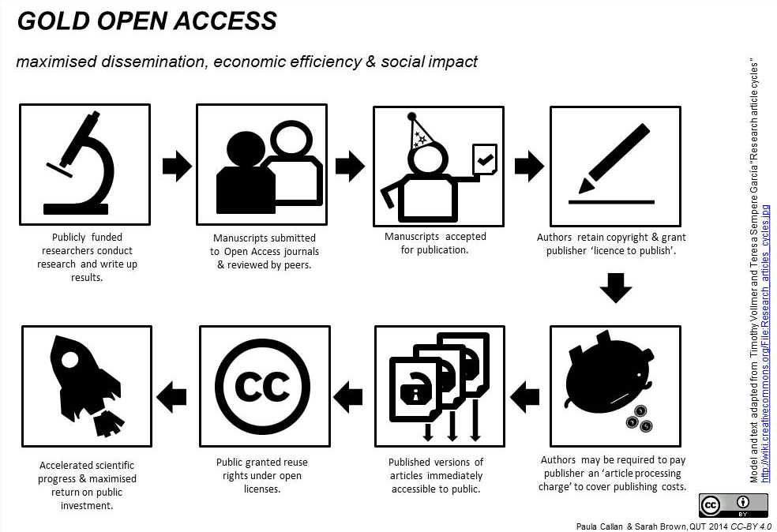
1
Notes:
Titre de la présentation
07/03/19
Université de Rennes 1
1
Gold Open Access does not necessarly mean that you will have to pay to be published in open access. Sometimes the journal will not ask you to pay anything but still with examine your work with the scrutiny and expertise that it requires.
Sometimes the journal is supported by public funds, like former University press which were at the beginning non for profit and for that reason will not charge you any APC (article Processing Charges). Diamond OA is prevalent in South America, but less developped in USA and Europe.
more and more journals ask you to pay to be published.
For some publishers, the cost of these publications must be added to the cost of access: this is the case for hybrid journals : institutions like universities or laboratories pay twice, once to subscribe to content, another time to publish the articles of their researchers.
This kind of situation is a trap.
The APC have raised three times more than the inflation from 2015 to 2020.
The average cost for papers published by University de Lorraine was in 2020, 2041 euros.
the steady increase of APC threatens universities budgets.
APC have another disadvantage : it seems as if whatever is the quality of the manuscript, researchers only had to pay in order to be published. this business model can diminish the confidence in scientific publications among the public.
Article Processing Charges is not correlated with real publication costs (realistic prices would be then now higher than 400 dollars per article). They are correlated with the prestige of the journal. Scientific institutions do not buy credits for publication, they buy prestige for their scholars.

Slide 29
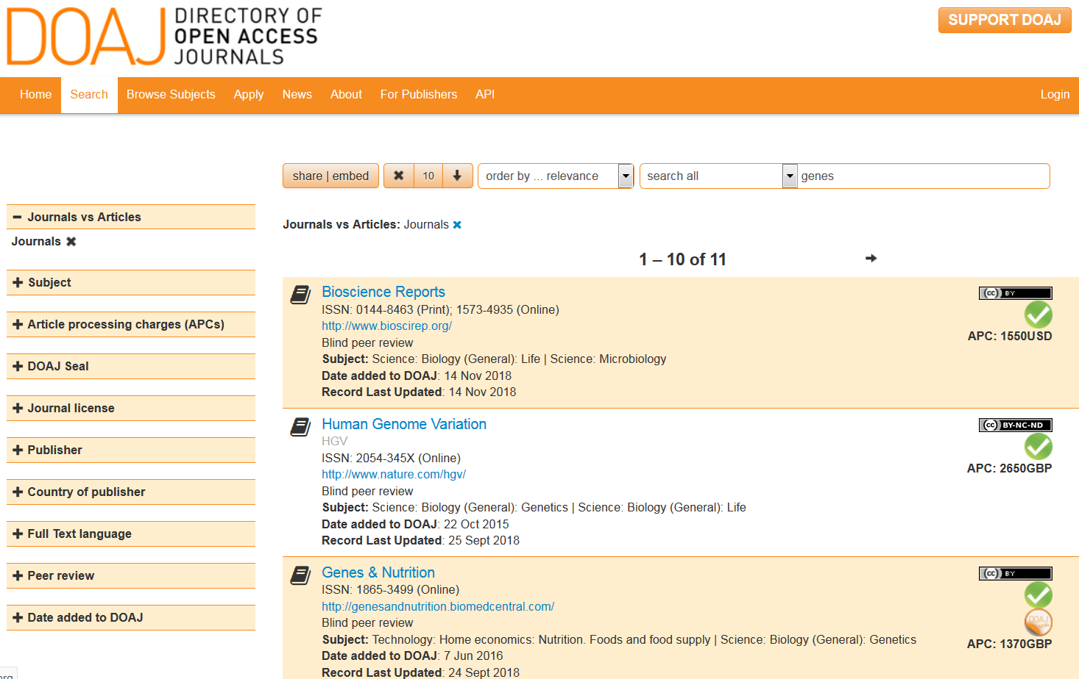
1
Notes:
Titre de la présentation
07/03/19
Université de Rennes 1
1
Depositing a copy of your PhD dissertation began compulsory in january 2013 at INSA Rennes and Rennes 1 University
The author decides if the thesis will be accessible to all or only to the University affiliates.
Different procedures for PhD dissertations and medical practice thesis : see Rennes 1 website (contrat de diff, etc.).
How to deposit your thesis : dépôt dans ENT avant soutenance / contrat de diffusion (diffusion restreinte ou intégrale / avec ou sans embargo)
confidentiality agreeement : must be limited to 5 years max (every exception must be duly argued).
Titre de la présentation
Université de Rennes 1
1

Slide 30
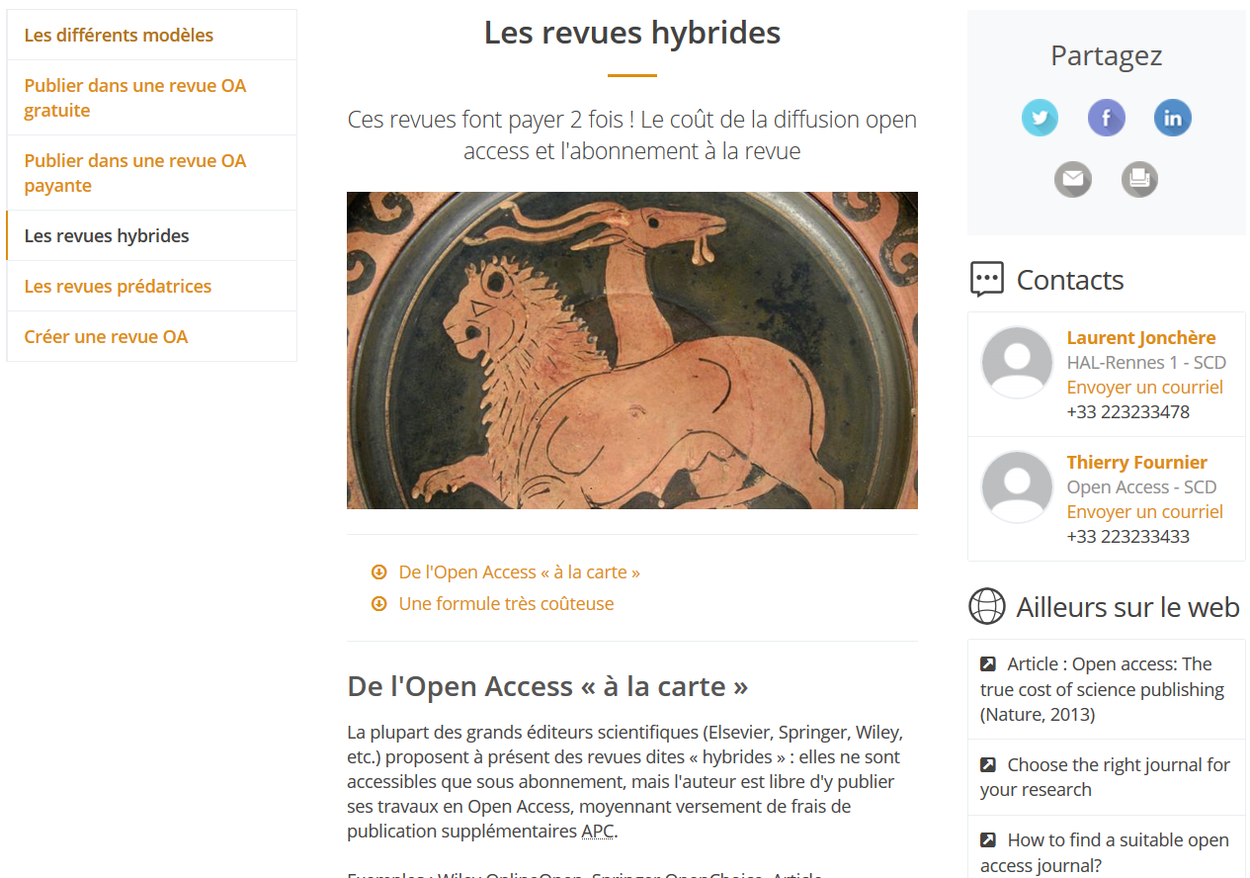
1
Notes:
Titre de la présentation
07/03/19
Université de Rennes 1
1

Slide 31
Klaxoon : third question
https://app.klaxoon.com/join/N5FUXQS

Slide 32

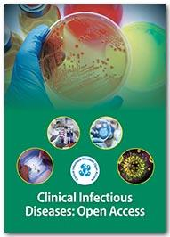

Are these journals are reliable as targets for a publication?
 | Polish Journal of Science
 | Clinical Infectious diseases : open access
 | Journal of imaging
Notes:
Answers :
Polish Journal of Science
Editor in chief and board members cannot be found. You have to trust the journal when they say that they are experts in the field (by the way: which field exactly?)
Journal is absent from the DOAJ directory
The journal is said to be indexed in “Skopus” (see in the footer : “the journal is registered in Skopus and Web of Science”, with a typo on Scopus) and web of science.
The journal is said to be indexed in Web of Science but it is not the case
the publication fees are very low (27 dollars) not very realistic.
On Google Street View, one cannot see a publishing company, only an electrical good stores
doubtful inpact factors (Cosmos, SIS) are mixed with media platforms (Slideshare, issuu) non specialized in science communication
Cosmos impact factor is a fraudulent metric which is usually mentioned by open access journals to make scholars think they have a real impact. See this article on Fraudulent metrics that try to impersonate reputed metrics like ISI impact factor.
Clinical Infection diseases : open access
a short review of the Wikipedia article dedicated to the publisher of this journal (the request on the journal title is automatically redirected to the article describing the publisher (OMICS publishing group) gives what we should think about it.
this journal tries to high-jacks the Clinical Infection diseases journal which is a well-established one. See What you need to know about hijacked journals
Journal of imaging
is indexed in the DOAJ directory, which is a good thing
is member of the ASPA (Open Access Scholarly Publishers Association (good reference)
is member of the COPE alliance
BUT
there has been important critcism on ForBetterScience website
In september 2018, a lot of editors left the publisher because MDPI were urging them to publish low-quality papers (there was a paper in Science Magazine about that)
According to some scholars, they spam a lot (see here)
Conclusion
though Journal of Imaging belongs to a questionable publisher, along these three journals, it appears to be the more serious.

Slide 33
Tools to discriminate predatory open access publishers
What do the Wikipedians tell about it (if they tell something)?
Does the open access journal appears in the DOAJ directory, Web of Science or COPE directory
Have you tried the “Compass to publish test” on this journal? (sorry, this one is not available in english)

Slide 34
Klaxoon : fourth question
https://app.klaxoon.com/join/N5FUXQS

Slide 35
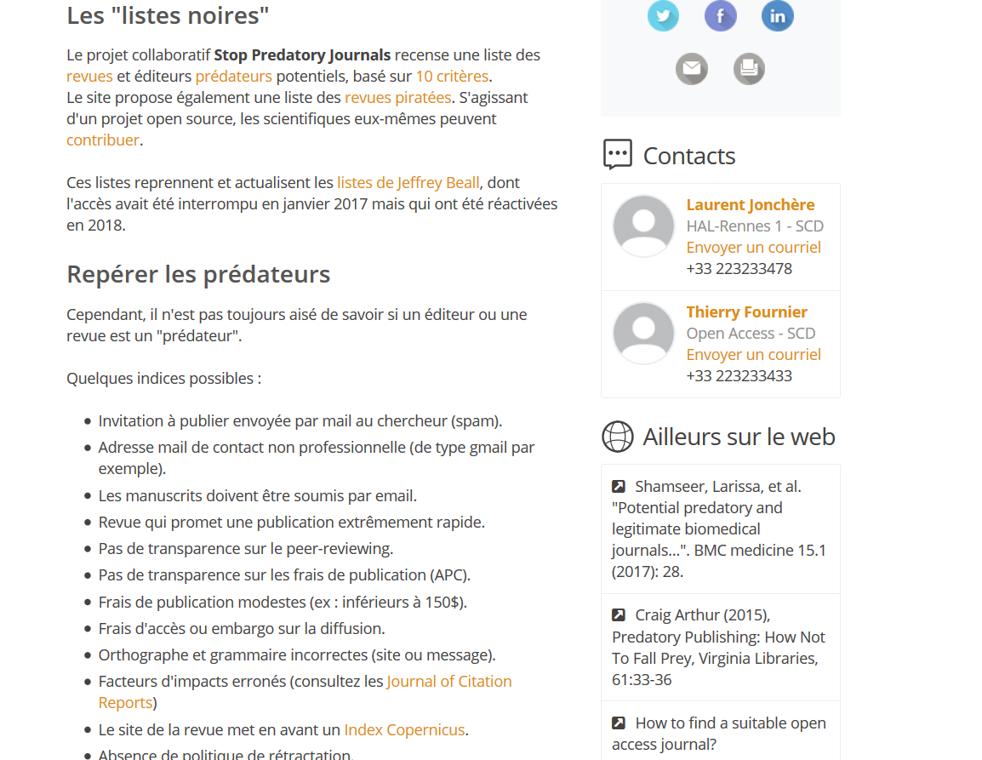
Notes:
Titre de la présentation
07/03/19
Université de Rennes 1
Définition et principes du Gold Open Access.
Le GOA : pas nécessairement payant (APC)
Argument de la vitesse à nuancer car peer-reviewing aussi long : surtout pour visibilité étendue.
Titre de la présentation
Université de Rennes 1

Slide 36


Notes:
Titre de la présentation
07/03/19
Université de Rennes 1
Des outils pour trouver et évaluer la fiabilité d'une revue OA (DOAJ...)
DOAJ seal = récompense un taux élevé d’ouverture (DOI, métadonnées articles, archivage, licences, etc.)
Titre de la présentation
Université de Rennes 1

Slide 37
Scientific Publishing models
Subscription journals
Open archiving
Commercial open access publishing
Non-profit Open Access publishing (aka Diamond Open Access)
Funders requirements for Open Access
Notes:
Titre de la présentation
07/03/19
Université de Rennes 1
The Open Access trend is polluted by opportunists : predatory open access publishers (rather impostors than predators, since the most predatory publishers are stakeholders like Elsevier
https://openaccess.univ-rennes1.fr/les-revues-predatrices
Articles acceptés, quelle que soit leur valeur scientifique
Fake editorial boards, sometimes with names of persons who are unaware of the existence of this so-called journal
Blacklist of predatory publishers and journals names on Rennes 1 website.
Titre de la présentation
Université de Rennes 1

Slide 38
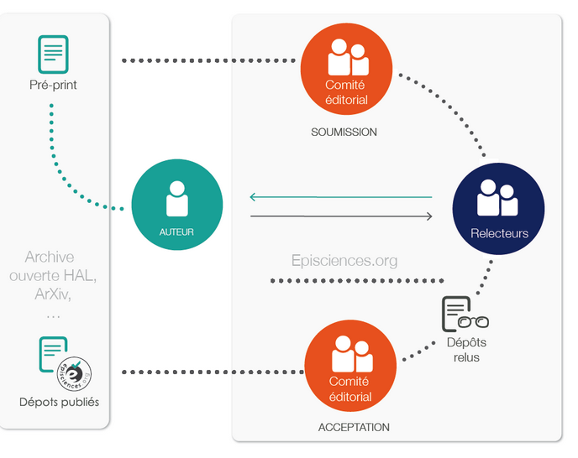
Notes:
Titre de la présentation
07/03/19
Université de Rennes 1

Slide 39
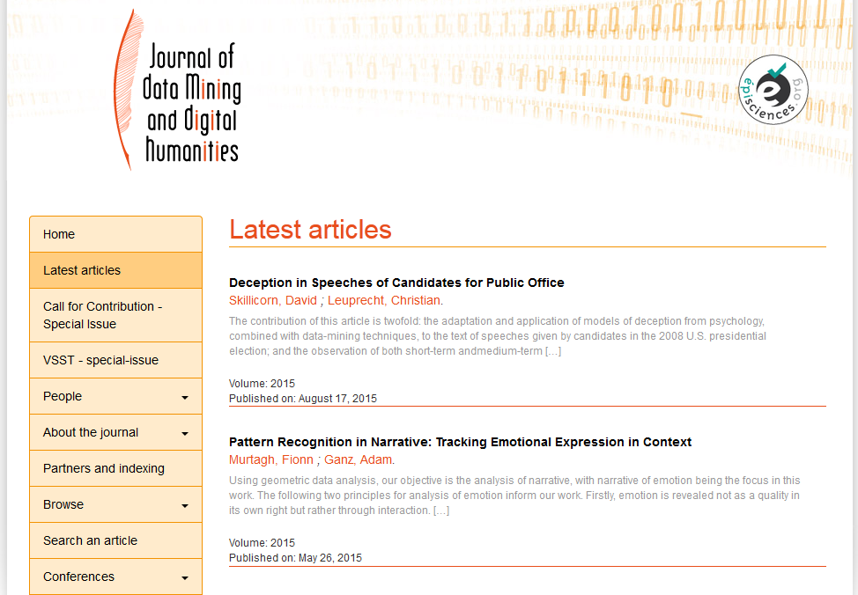
Notes:
Titre de la présentation
07/03/19
Université de Rennes 1
Aussi vrai pour les thèses : exemple des Editions universitaires européennes, VDM Publishing, Scholar's Press, etc.
Pas de relecture scientifique / impression à la demande.
Les doctorants ont plus intérêt à permettre la diffusion Internet au moment du dépôt électronique de leur thèse.
En cas de signature d'un contrat de cession de droit chez l'un de ces éditeurs, ce contrat devra comporter une clause de cession non exclusive afin que l’établissement de soutenance ne soit pas contraint de suspendre l'actuelle diffusion numérique, à laquelle il est par ailleurs tenu par la réglementation nationale (Arrêté du 7 août 2006 sur le dépôt, le signalement, la reproduction, la diffusion et la conservation des travaux présentés en soutenance en vue du doctorat).
Titre de la présentation
Université de Rennes 1

Slide 40
Diamond Open Access or How to restore University Presses in a context of predation and Open Access
Journals mainly controlled and developped by researchers themselves (= non for profit)
these journals are under-represented in main bibliometric databases (Scopus, Web of Science)
in some countries (Latin America), this way of publishing is far more important than anywhere else (Scielo)
The second version of European Plan S restores the development diamond open access as a condition to bibliodiversity

Slide 41
Scientific publishing models
Subscription journals
Open archiving
Commercial open access publishing
Non-profit Open Access publishing (aka Diamond Open Access)
Funders requirements for Open Access
Notes:
Titre de la présentation
07/03/19
Université de Rennes 1

Slide 42
Plan S
Who? https://www.coalition-s.org/
European funders (among them french ANR)
« Making full and immediate Open Access a reality »
Rights retention strategy to sustain an open access model without embargo
publishing in hybrid journals becomes prohibited
incentives to archive papers in repository (CC-BY)
one can publish in a pay-walled paper provided the journal is included in a transformative agreement between publishers and funders
a data management plan is required linked to the publication
Notes:
Titre de la présentation
07/03/19
Université de Rennes 1
transformative agreement is also called “publish and read” agreement, which means that consortia will negotiate with publishers the right to access to papers, and the right to publish (the amount of APC per year) in the same deal.
instead of negotiating subscription fees for X journals and paying extra APC, as in the past, a transformative agreement will include access to those X journals + the right to publish N papers a year in those X journals in the negociation.
This is a bad thing for academic freedom and diversity of publishing models, since publishers will be incentived to publish in journals covered by these transformative agreements in their university rather than in pure open access players (see for instance this list of journals covered by a transformative agreement at the U-PEC university https://bibliotheque.u-pec.fr/savan/comment-publier/revues-avec-remise-partielle-ou-complete-des-apc
The transformative journals should be year after year converted from subscription model to open access journals, but in fact, when the contract is over, there is a risk that these journals go back the the all subscription model.

Slide 43

Thank you for your attention!
https://openaccess.univ-rennes1.fr/
Contacts :
Damien Belvèze
damien.belveze@univ-rennes1.fr
Laurent Jonchère
laurent.jonchere@univ-rennes1.fr
Notes:
Titre de la présentation
07/03/19
Université de Rennes 1
Comparaison avec HAL
Important : RG n’est pas une archive ouverte !
Titre de la présentation
Université de Rennes 1

